Slide 1
Data Analytics
Statistical Concepts
Presented By: Sakshi Dhandole

Slide 2
CONTENTS
Introduction
Population and Sample
Sampling Techniques
Data
Statistical Measures
Measures of Dispersion
Correlation
Graphs for Statistical Analysis
Percentile and Quartile
Five-Number Summary
Probability

Slide 3

1. Introduction
What is Statistics?
A branch of mathematics which deals with gathering, organizing, analyzing, and interpreting the data.
Statistics refers to dealing with quantitative information
Statistics is the sciences and art of dealing with figure and facts.
Applications: Research, AI/ML, Business Intelligence, Finance, Healthcare.
Types:
Descriptive Statistics
Inferential Statistics

Slide 4
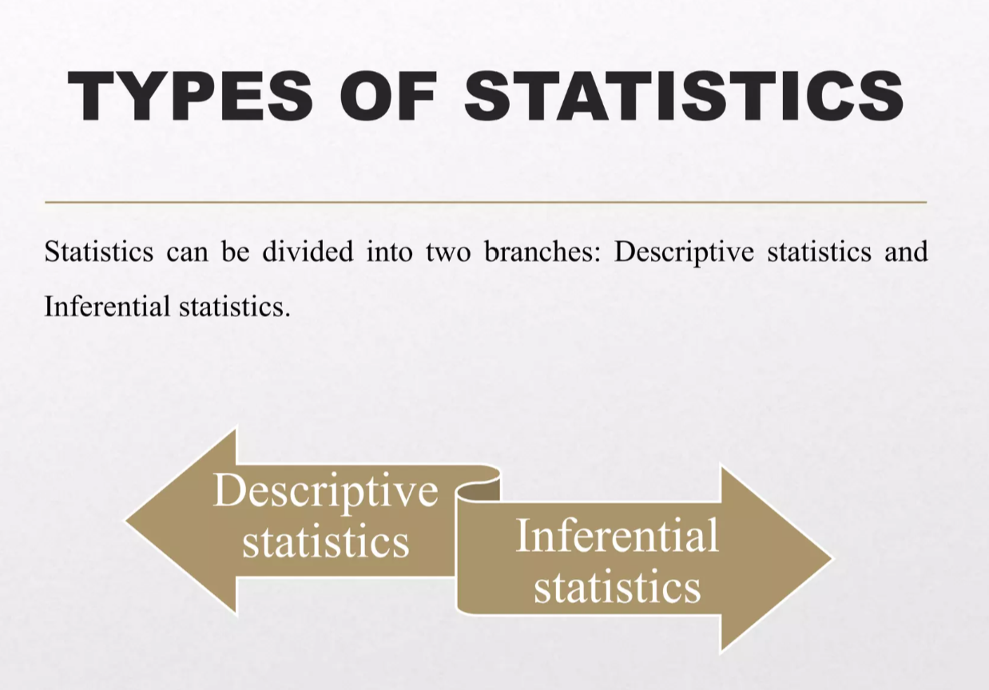

Slide 5
1. Descriptive Statistics
Descriptive statistics deals with methods of collecting, organizing, summarizing, and presenting data in a meaningful way.
Examples: Mean, Median, Mode, Graphs, Tables.
Purpose: To describe the characteristics of a dataset.
2. Inferential Statistics
Inferential statistics involves methods that allow us to make predictions, draw conclusions, or generalize about a population based on information from a sample.
Examples: Hypothesis testing, t-test, Chi-square, Regression.
Purpose: To make inferences and decisions about large groups using sample data.

Slide 6
Interview Questions
1. What is the difference between descriptive and inferential statistics?
Descriptive statistics: Summarizes and describes data using mean, median, mode, SD, graphs, etc. It tells what the data shows.
Inferential statistics: Uses sample data to make predictions or conclusions about a larger population. It tells what the data implies.
2. Can you give real-world examples of where each type is used?
Descriptive statistics: Average salary of employees in a company, or plotting a histogram of students’ marks.
Inferential statistics: Predicting election results from a survey, or estimating population health trends from a sample.

Slide 7
3. Why do we need statistics in data analysis? Statistics helps us summarize, understand, and interpret data. It allows us to make decisions, predictions, and informed business or research choices. 4. Give an example of descriptive statistics in real life. Example: A company finds the average monthly sales, the median sales, and plots a sales distribution chart. This tells the company how sales are performing overall. 5. What are some applications of statistics in business/AI/healthcare? Business: Customer segmentation, market analysis, sales forecasting. AI/Data Science: Model evaluation, feature selection, predictive analytics. Healthcare: Analyzing patient outcomes, clinical trials, disease prediction.

Slide 8
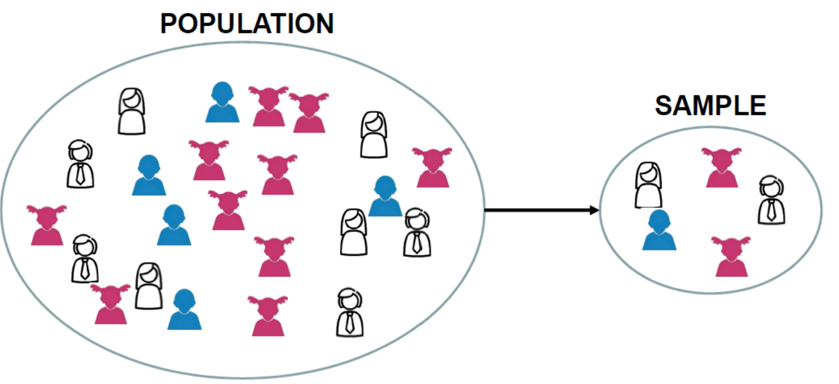
2. Population and Sample
Population The complete set of all items or individuals under study.
Includes every element that fits the criteria.
It is denoted by (N).
Example: All students in a university.
Sample A smaller group selected from the population to represent it.
It is denoted by (n).
Used when studying the entire population is not possible.
Example: 200 students chosen from the university.

Slide 9
Interview Questions
1. What is the difference between population and sample?
Population: The entire group you want to study.
Sample: A subset of the population that represents it.
Example: All students in a university = population; 100 randomly selected students = sample.
2. Why do we prefer using samples instead of the whole population?
It’s faster, cheaper, and easier than collecting data from everyone.
Often, a well-chosen sample gives almost the same information as the population.

Slide 10
3. How do you determine the right sample size? Depends on: Population size Desired confidence level (e.g., 95%) Margin of error (how precise you want the results) Variability in the data (more variability → larger sample needed) 4. Give an example of population and sample in a real-world scenario. Population: All employees in a company. Sample: 50 employees randomly selected to survey job satisfaction. 5. What happens if the sample is not representative of the population? Results can be biased or misleading. Decisions or predictions based on the sample may not reflect the real population. Example: Surveying only male employees about benefits will not represent the views of all employees.

Slide 11
3.Sampling Techniques
Sampling is the process of selecting a subset (sample) from a population to make conclusions about the whole population.
Simple Random Sampling
Every member of the population has an equal chance of being selected.
Example: Picking 100 students randomly from a university.
2. Stratified Sampling
Population is divided into strata (groups) based on characteristics, then samples are taken from each group .
Example: If a college has 4 departments, we take some students from each department to make the sample.

Slide 12
3. Systematic Sampling Every nth member of the population is selected after a random start. Example: Selecting every 10th voter from a list. 4.Convenience Sampling Take samples from people who are easiest to reach. Example: Asking your friends in class for opinions. Note: Quick and easy, but may not represent everyone. 5. Purposive (Judgment) Sampling Take samples based on researcher’s choice or judgment. Example: A doctor selects only patients with a certain disease for a study. Note: Used when we need specific people or items. 6. Cluster Sampling Population is divided into clusters, and entire clusters are randomly selected. Example: Selecting 5 schools out of 20, then including all students from chosen schools.

Slide 13
Interview Questions
1. Explain simple random sampling with an example.
Simple random sampling: Every member of the population has an equal chance of being selected.
Example: Picking 50 students randomly from a university where each student has an equal chance to be chosen.
2. What is the difference between stratified and cluster sampling?
Stratified sampling: Population is divided into groups (strata) based on characteristics, and samples are taken from each group. Example: Selecting 10 students from each department.
Cluster sampling: Population is divided into clusters, and entire clusters are randomly selected.
Example: Randomly selecting 5 schools out of 20, then including all students from those schools.
3. How does systematic sampling work?
Systematic sampling: Selects every kth member from a population list.
Example: Surveying every 10th customer entering a store.

Slide 14
4. What are the drawbacks of convenience sampling? Convenience sampling: Selecting people who are easiest to reach. Drawbacks: Biased results Not representative of the population Cannot generalize findings to the whole population 5. What is purposive (judgmental) sampling? When is it used? Purposive sampling: Researchers select participants based on their knowledge, experience, or judgment. Used when: Studying specific expert opinions or when the population is hard to reach. Example: Interviewing only doctors about a new medical procedure. 6. Which sampling method gives the most accurate results? Simple random sampling and stratified sampling are usually the most accurate because they reduce bias and better represent the population.

Slide 15
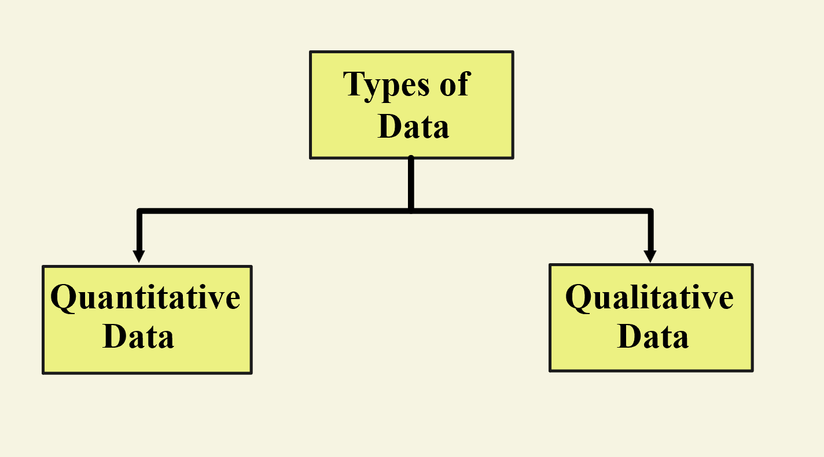
4.Data
Data is a collection of facts, numbers, or information that can be analyzed to make decisions or draw conclusions.

Slide 16
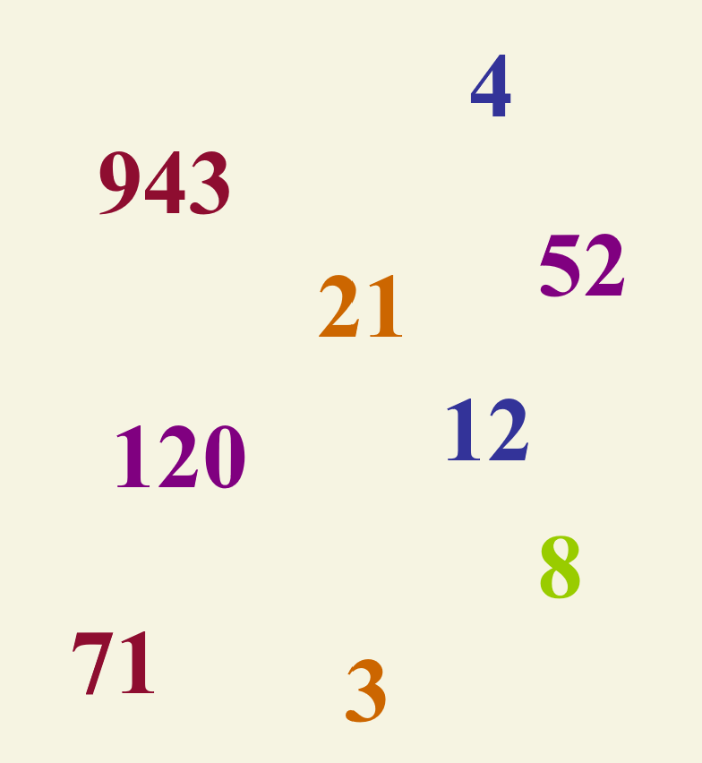
Quantitative Data (Numerical)
Represents numbers and quantities.
Types :
1.Discrete Data: Countable values
Example: Number of students in a class
2.Continuous Data: Measurable values
Example: height, weight, temperature

Slide 17


Qualitative Data (Categorical)
Qualitative data represents qualities, categories, or labels, not numbers.
Examples: Gender (Male/Female), Blood Group (A, B, AB, O)
Types of Qualitative Data:
Nominal Data
Categories without any order or ranking.
Example: Colors (Red, Blue, Green), Blood Group (A, B, AB, O)
Ordinal Data
Categories with a natural order or ranking, but differences are not measurable.
Example: Education Level (High School < Bachelor < Master)

Slide 18
Interview Questions
1. What is the difference between qualitative and quantitative data?
Qualitative data: Describes qualities or categories, usually non-numeric.
Example: Eye colour, gender, type of car.
Quantitative data: Measures numbers or amounts, numeric in nature.
Example: Age, height, salary.
2. Explain discrete vs continuous data with examples.
Discrete data: Can take only specific values (countable).
Example: Number of students in a class, number of cars.
Continuous data: Can take any value within a range (measurable).
Example: Height, weight, temperature.

Slide 19
3. What is the difference between nominal and ordinal data? Nominal data: Categories without any order. Example: Blood type (A, B, AB, O), favourite color. Ordinal data: Categories with a meaningful order, but differences between values are not exact. Example: Ratings (poor, average, good, excellent). 4. Give real-world examples of categorical data. Gender (Male/Female) Car brands (Toyota, Honda, Ford) Education level (High School, Bachelor, Master) 5. Why is it important to classify data types correctly before analysis? Correct classification ensures proper statistical methods and visualizations are used. Wrong classification can lead to incorrect conclusions. Example: Using mean for categorical data like color makes no sense. 6. How would you handle ordinal data in analysis? Ordinal data can be analyzed using: Median or mode (measures of central tendency). Bar charts or stacked charts for visualization. Assign numeric ranks if needed, but be careful: differences between ranks may not be equal.

Slide 20
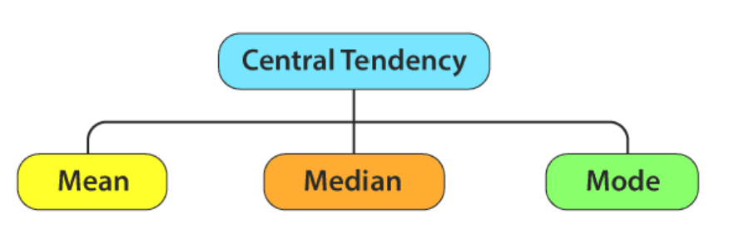
5.Statistical Measures
1. Measure Of Central Tendency
Central Tendency is a statistical measure that identifies a single value as the representative of an entire dataset.
Central tendency means central value of a statistical series.

Slide 21
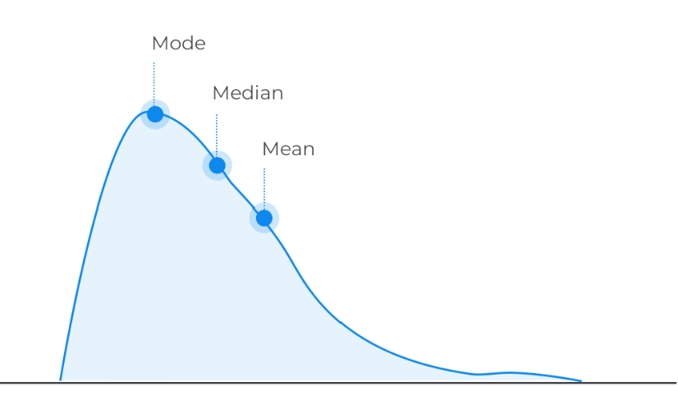
Mean (Average): Add all values and divide by the number of values. Example: For [10, 20, 30], Mean = (10 + 20 + 30) ÷ 3 = 20 Median (Middle Value): The middle value when numbers are arranged in order. Example: For [5, 10, 15, 20, 25], Median = 15 (the middle number) Mode (Most Frequent Value): The value that appears most often. Example: For [2, 3, 3, 5, 7], Mode = 3 (since it repeats)

Slide 22
Trimmed Mean A type of average where you remove a certain percentage of the smallest and largest values before calculating the mean. It use to reduce the effect of extreme values (outliers). Example: Data = [10, 12, 14, 15, 90] If we remove the lowest (10) and highest (90), Trimmed Mean = (12 + 14 + 15) ÷ 3 = 13.67 Weighted Mean A mean where each value is given a weight (importance), instead of treating all values equally. Useful when some data points are more significant than others (e.g., grades, percentages). Formula: Weighted Mean = (Σ w·x) ÷ (Σ w) where w = weight, x = value. Example: A student scores: Test 1: 80 (weight 40%) Test 2: 90 (weight 60%) Weighted Mean = (80×0.4 + 90×0.6) ÷ (0.4+0.6) = (32+54)/1 = 86

Slide 23

Interview Questions
1. Define mean, median, and mode with examples.
Mean: Average of all values.
Example: Data = 2, 4, 6 → Mean = (2+4+6)/3 = 4
Median: Middle value when data is arranged in order. Example: Data = 2, 4, 6 → Median = 4 Data = 2, 4, 6, 8 → Median = (4+6)/2 = 5
Mode: Value that occurs most frequently. Example: Data = 2, 2, 4, 6 → Mode = 2
2. When would you prefer median over mean?
Use median when data has outliers or skewed distribution because mean gets affected by extreme values.
Example: Salaries in a company: 30k, 35k, 40k, 1,00,000 → Median gives a better central value.

Slide 24
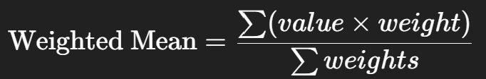
3. What is a trimmed mean and why is it useful? Trimmed mean: Mean calculated after removing a certain percentage of lowest and highest values. Useful: Reduces the effect of outliers while still using most of the data. 4. What is a weighted mean? Give an example. Weighted mean: Average where each value has a different importance (weight). Weighted Mean= Example: Student scores: Math = 80 (weight 2), English = 70 (weight 1) → Weighted Mean = (80×2 + 70×1)/(2+1) = 76.7 5. How do outliers affect the mean? Outliers pull the mean toward themselves, making it less representative of the data. 6. Which measure of central tendency is most robust against outliers? Median is the most robust because it is not affected by extreme values.

Slide 25
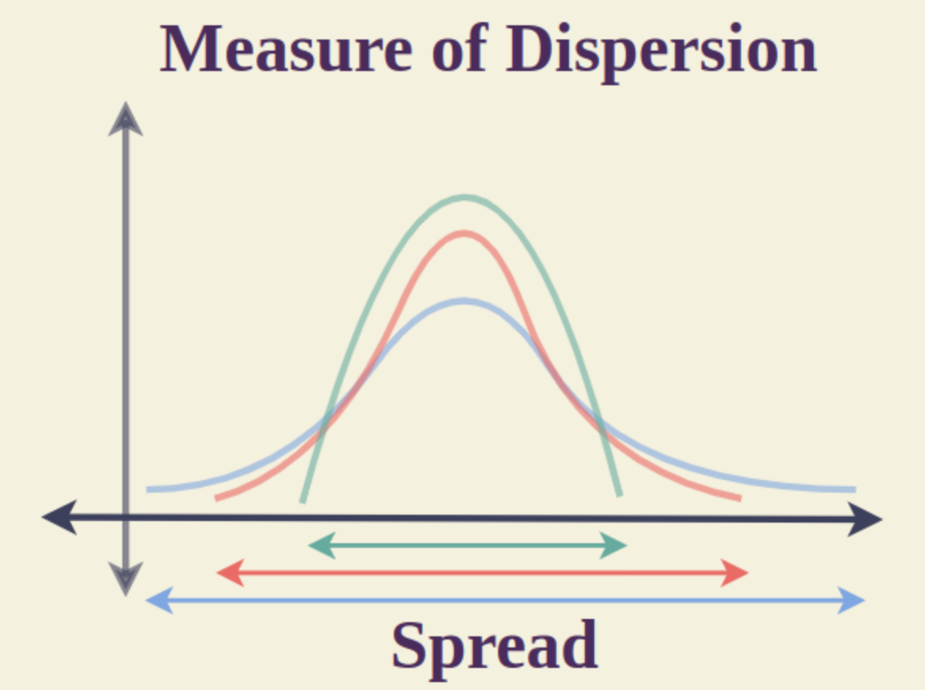

6. Measures of Dispersion
Measures of Dispersion are statistical tools that describe the spread or variability of data values in a dataset.
They indicate how much the data deviates from the central value (mean, median, or mode).
Variations:
1. Range
The range is difference between the largest and smallest value.
Example: Data = [5, 8, 12, 20] Range = 20 − 5 = 15
Formula:

Slide 26
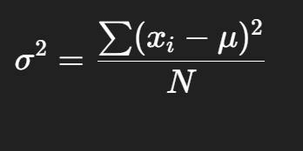
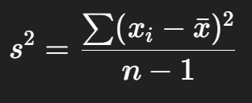
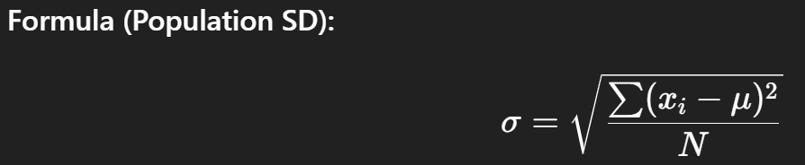
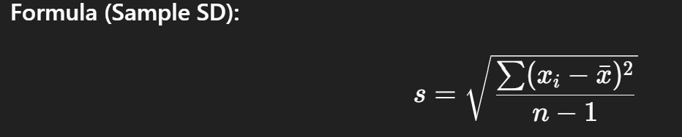
2. Variance The average of the squared differences from the mean. Example: Data = [2, 4, 6] Mean = 4 Variance = [(2−4)² + (4−4)² + (6−4)²] ÷ 3 = (4 + 0 + 4) ÷ 3 = 2.67 Formula: 3. Standard Deviation (SD) Square root of variance. It shows the average distance of values from the mean. Example: From above, Variance = 2.67 SD = √2.67 ≈ 1.63

Slide 27
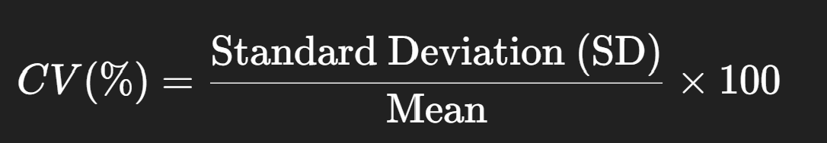
4.Coefficient of Variation (CV) The Coefficient of Variation (CV) is a statistical measure that shows the relative variability of data in comparison to the mean. It is expressed as a percentage and helps compare the spread of two or more datasets with different units or means. Formula:

Slide 28
Interview Questions
1. What is the difference between variance and standard deviation?
Variance: Measures the average squared distance of each data point from the mean.
Standard Deviation (SD): Square root of variance. Shows spread in the same units as data, making it easier to interpret.
2. What does a high standard deviation indicate about your data?
A high SD means the data points are widely spread from the mean.
A low SD means the data points are closer to the mean.
3. How is the coefficient of variation (CV) used in comparison?
CV = (Standard Deviation / Mean) × 100%
It allows comparison of spread between datasets with different units or means.
Example: Comparing variation in heights vs weights – CV makes it comparable.

Slide 29
4. Why is IQR (Interquartile Range) more reliable than range? Range only considers the minimum and maximum, so it’s affected by outliers. IQR looks at the middle 50% of data (Q3 – Q1), ignoring extremes, so it gives a more stable measure of spread. 5. How do you identify outliers using standard deviation or IQR? Using SD: Values more than 2 or 3 SDs from the mean are often considered outliers. Using IQR: Values below Q1 – 1.5 × IQR or above Q3 + 1.5 × IQR are outliers. 6. Why is standard deviation preferred over variance in interpretation? Variance is in squared units, which is hard to relate to original data. SD is in the same units as the data, so it is easier to understand and interpret. 7. Why do we divide by n–1 when calculating sample variance? If sampling technique is biased. Then the sample variance is far away from population variance because of mean . So, if we divide sample variance by (n-1) then we have the possibilities of sample variance is approximately equal to population variance.

Slide 30
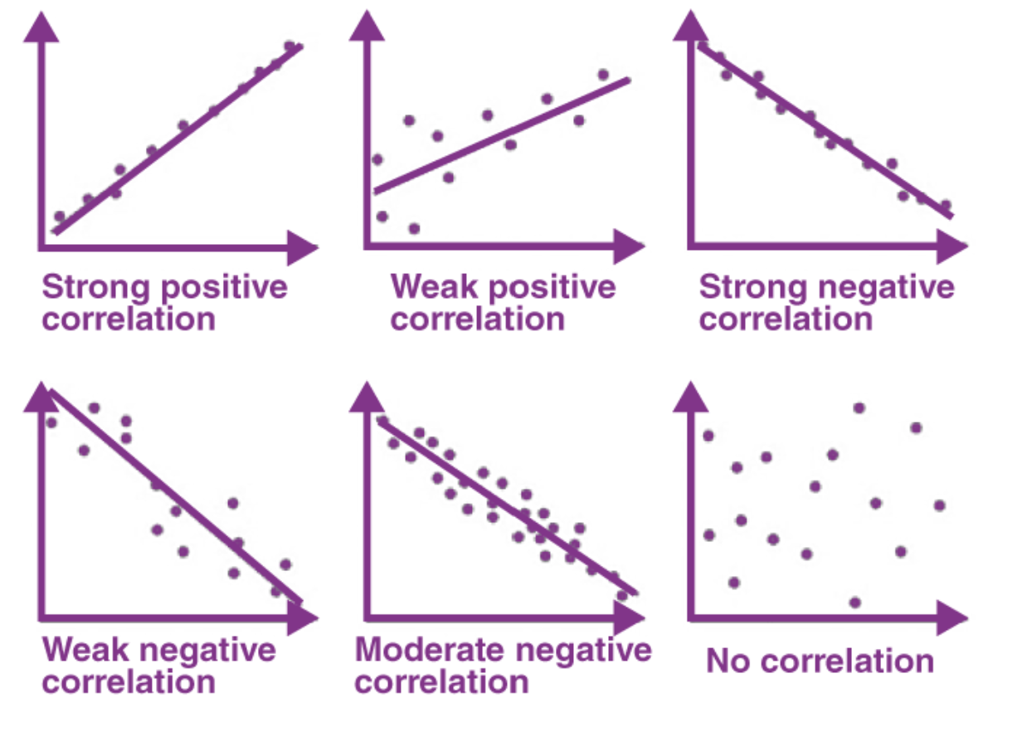
7.Correlation
Correlation measures the strength and direction of the relationship between two variables. It shows how one variable changes in relation to another.
Range:
Correlation coefficient ranges from −1 to +1
Types Of Correlation
1. Pearson Correlation Pearson correlation is a statistical measure that calculates the strength and direction of the linear relationship between two continuous numerical variables.
Values range from −1 to +1

Slide 31
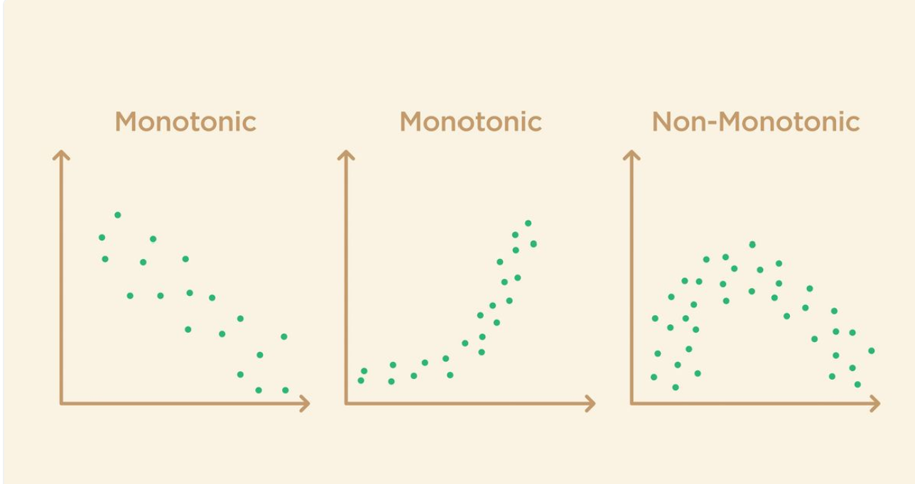
Spearman’s Correlation
Spearman correlation is a statistical measure that calculates the strength and direction of the monotonic relationship between two variables using their ranks instead of actual values.
Values also range from −1 to +1

Slide 32
Interview Questions
1.What is the difference between correlation and causation?
Correlation: Measures how two variables move together, but doesn’t mean one causes the other.
Causation: Means one variable directly causes changes in another. Example: Ice cream sales and drowning incidents are correlated (both increase in summer) but ice cream doesn’t cause drowning.
2. Explain Pearson’s correlation and when it’s used.
Pearson’s correlation measures the linear relationship between two continuous numerical variables.
Values range from -1 to +1.
Used when data is normally distributed and relationship is linear.

Slide 33
3. Explain Spearman’s correlation and when it’s used. Spearman’s correlation measures monotonic relationship (increasing or decreasing) between variables using their ranks. Used when data is not normally distributed or the relationship is non-linear. 4. What does a correlation coefficient of +1, 0, -1 mean? +1: Perfect positive correlation (as one increases, the other increases perfectly). 0: No correlation (variables are not related). -1: Perfect negative correlation (as one increases, the other decreases perfectly). 5. Give a real-world example of positive correlation and negative correlation. Positive correlation: Height and weight – taller people usually weigh more. Negative correlation: Number of hours spent watching TV vs exam scores – more TV, lower scores. 6. Can two variables be correlated but not causal? Example? Yes, correlation does not imply causation. Example: Number of people eating ice cream and drowning incidents both rise in summer. They are correlated, but eating ice cream does not cause drowning.

Slide 34
8. Graphs for Statistical Analysis
Graphs for Statistical Analysis are visual representations of data used to summarize, explore, and interpret information. They help in understanding patterns, trends, relationships, and distributions of variables in a dataset.
Types of Analysis:
Univariate: Analyzes one variable
Bivariate: Analyzes two variables and their relationship
Multivariate: Analyzes three or more variables simultaneously

Slide 35
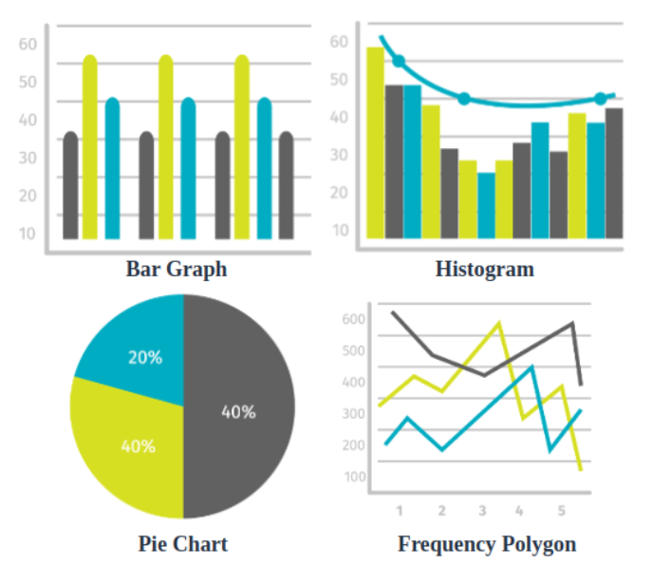
Univariate Analysis
Univariate Analysis Univariate analysis examines one variable at a time to understand its distribution, patterns, and characteristics.
Key Tools & Graphs:
Bar Chart – Displays frequency of categorical data.
Relative Frequency – Shows proportion of each category relative to total.
Cumulative Frequency – Shows running total of frequencies, helpful for percentiles.
Numerical Feature Analysis – Analyzing mean, median, mode, variance, SD for numerical data.
Distribution of Numerical Feature – Using Histogram or Box Plot to visualize spread, and outliers.

Slide 36
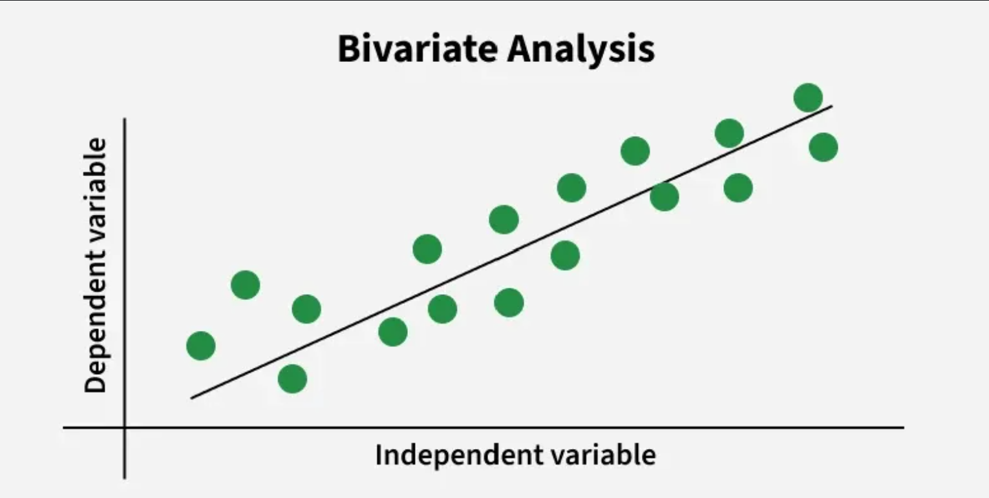
Bivariate Analysis
Bivariate Analysis (Two Variables)
To understand the relationship or association between two variables.
Helps identify patterns, correlations, or trends.
Common Graphs:
Scatter Plot → Shows relationship/correlation between two numerical variables.
Line Graph → Shows trend over time for two variables.
Stacked Bar Chart → Compares two categorical variables.

Slide 37
Multivariate Analysis
Multivariate Analysis (More than Two Variables) Multivariate analysis studies three or more variables simultaneously to understand complex relationships, patterns, and interactions.
Common Graphs:
3D Scatter Plot → Shows relationship among 3 numeric variables (x, y, z).
Bubble Chart → Represents 3 variables (x, y, bubble size).
Heatmap → Displays correlation matrix or intensity among multiple variables.
Multiple Line Graphs → Compares trends of several variables over time.

Slide 38
Interview Questions
1. What is the difference between univariate, bivariate, and multivariate analysis?
Univariate Analysis: Analyzes one variable at a time. Example: Finding mean or median of students’ marks.
Bivariate Analysis: Analyzes two variables to see the relationship between them. Example: Studying hours vs marks.
Multivariate Analysis: Analyzes more than two variables together. Example: Studying hours, marks, and attendance together to see performance patterns.
2. Which graphs are used for categorical data?
Bar chart – Compare categories.
Pie chart – Show proportion of categories.
Stacked bar chart – Compare multiple categorical variables.

Slide 39
3. Which graphs are used for numerical data? Histogram – Distribution of a single numerical variable. Box plot – Spread and outliers. Line graph – Trend over time. Scatter plot – Relationship between two numerical variables. 4. When would you use a scatter plot vs a line graph? Scatter plot: To see the relationship or correlation between two numerical variables. Example: Height vs weight. Line graph: To show trend over time or continuous data. Example: Sales over months. 5. What is the use of a box plot? A box plot shows the distribution of data based on the five-number summary (min, Q1, median, Q3, max). Helps identify spread, median, and outliers in the dataset.

Slide 40
6. How do you use a heatmap in correlation analysis? A heatmap is a color-coded table that shows correlation values between variables. Darker/lighter colors indicate stronger or weaker correlation. It helps quickly identify which variables are positively or negatively correlated.

Slide 41
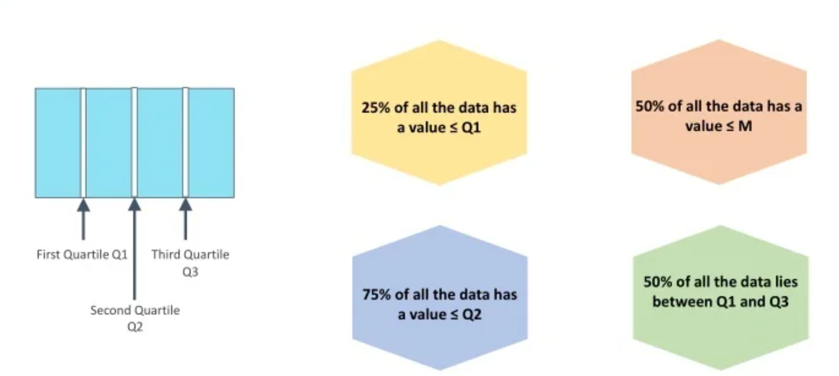
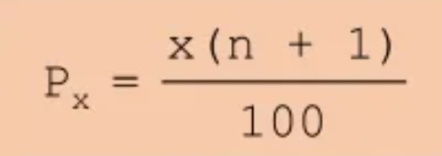
9.Percentile and Quartile
Quantile: A quantile is a statistical measure that divides an ordered dataset into equal-sized intervals based on rank or position.
Types of Quantiles
Quartiles :Divide data into 4 equal parts.
Quintiles :Divide data into 5 equal parts.
Deciles :Divide data into 10 equal parts.
Percentiles :Divide data into 100 equal parts.
Formula:

Slide 42
Interview Questions
1. What is a quantile?
A quantile is a value that divides a dataset into equal parts. For example, quartiles divide data into 4 parts, deciles into 10 parts, and percentiles into 100 parts.
2. What are quartiles (Q1, Q2, Q3)?
Q1 (First Quartile): 25% of the data lies below this value.
Q2 (Second Quartile / Median): 50% of the data lies below this value.
Q3 (Third Quartile): 75% of the data lies below this value.
3. Why is the median also called the 50th percentile?
The median is the middle value of a dataset, meaning 50% of the data is below it and 50% is above it. That’s exactly the definition of the 50th percentile, so both are the same.

Slide 43
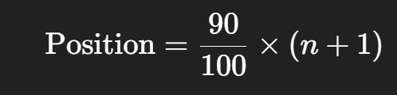
4. How do you calculate the 90th percentile of a dataset? Step 1: Arrange the data in ascending order. Step 2: Find the position using the formula: where n is the number of data points. Step 3: Locate the value at that position. 5. Where are percentiles used in real-world applications? Exams/Entrance tests: Percentile scores show how a student performed compared to others. Health: Percentile charts track children’s height/weight growth. Business: Percentiles are used in customer segmentation or risk analysis. Finance: Value at Risk (VaR) uses percentiles to measure potential losses.

Slide 44
6. What is the difference between quartile deviation and standard deviation? Quartile Deviation (QD): Based on the middle 50% of data (Q3 – Q1) / 2. Ignores extreme values, so less affected by outliers. Standard Deviation (SD): Uses all data points and measures average distance from the mean. More precise but sensitive to outliers.

Slide 45
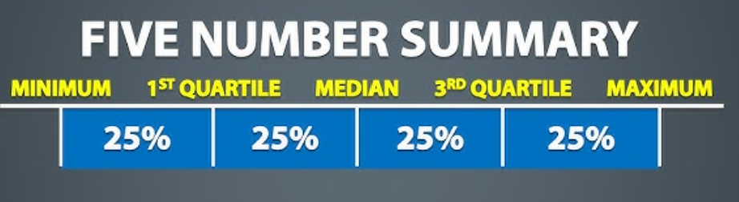
10.Five-Number Summary
The five-number summary is a set of five statistical values that describe the center, spread, and range of a dataset.
It provides a quick overview of the distribution.
The Five Numbers are:
Minimum → The smallest value in the dataset
Q1 (First Quartile) → 25% of data lies below this value
Median (Q2) → The middle value (50th percentile)
Q3 (Third Quartile) → 75% of data lies below this value
Maximum → The largest value in the dataset
Example :(Dataset: 2, 4, 7, 10, 15, 18, 20, 25, 30):
Minimum = 2 ,
Q1 = 7
Median (Q2) = 15
Q3 = 25
Maximum = 30

Slide 46
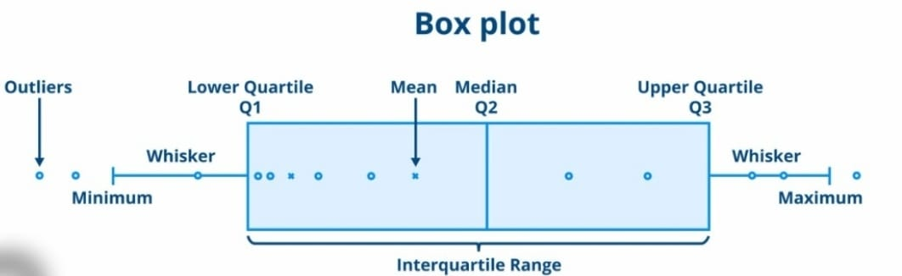

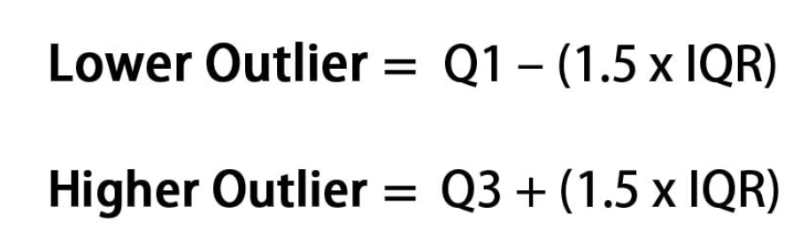
Interquartile Range (IQR)
The Interquartile Range (IQR) is a measure of statistical dispersion, which represents the range of the middle 50% of the data. It is calculated as the difference between the third quartile (Q3) and the first quartile (Q1).
Use:
Measures how spread out the central data values are.
Helps detect outliers (values lying far below Q1 or above Q3).
Formula:
Outlier Formula

Slide 47
Interview Questions
1. What are the components of a five-number summary?
The five-number summary has five key values that describe a dataset:
Minimum – the smallest value.
Q1 (First Quartile) – 25% of the data lies below this value.
Median (Q2) – the middle value.
Q3 (Third Quartile) – 75% of the data lies below this value.
Maximum – the largest value.
2. What is the IQR and why is it important?
The Interquartile Range (IQR) is the difference between the third quartile (Q3) and the first quartile (Q1):
IQR=Q3−Q1
It measures the spread of the middle 50% of the data.
It is important because it ignores extreme values (outliers) and gives a more reliable idea of how spread out the central data is.

Slide 48
3. How do you detect outliers using IQR? Outliers are values that lie too far from the rest of the data. Using IQR, the rule is: Any value below (Q1 – 1.5 × IQR) or Any value above (Q3 + 1.5 × IQR) is considered an outlier. 4.How is a box plot related to the five-number summary? A box plot is a visual representation of the five-number summary. The five numbers are: minimum, Q1, median, Q3, and maximum. 5. Why is IQR preferred over range as a measure of spread? The range only considers the smallest and largest values, so it can be heavily affected by outliers. The IQR (Interquartile Range) looks at the middle 50% of the data (Q3 – Q1), so it is more stable and reliable when there are extreme values. That’s why IQR is usually preferred.

Slide 49
6. If a dataset has many outliers, which measure of spread would you use? If the dataset has many outliers, I would use the IQR (Interquartile Range). This is because IQR focuses only on the middle 50% of data and ignores extreme values, making it a better measure of spread in such cases.

Slide 50
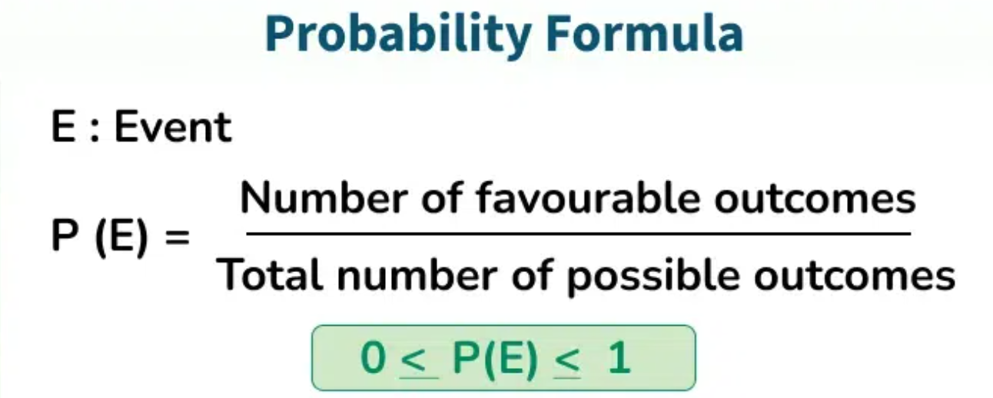
11.Probability
Probability is a numerical measure between 0 and 1 that quantifies the likelihood of an event.

Slide 51
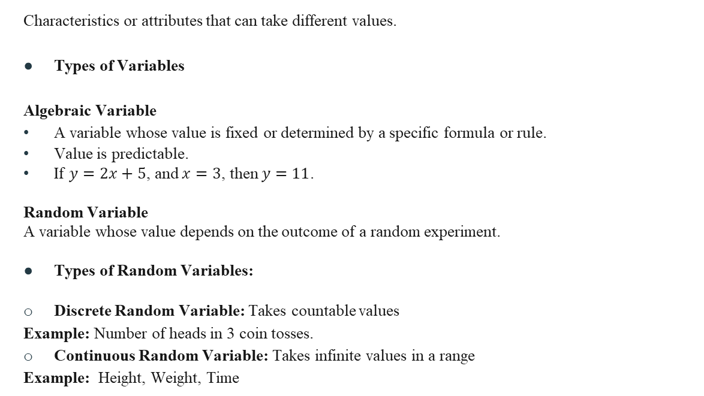
Variables
Characteristics or attributes that can take different values.
Types of Variables
Algebraic Variable
A variable whose value is fixed or determined by a specific formula or rule.
Value is predictable.
If $y=2x+5$, and $x=3$, then $y=11$.
Random Variable
A variable whose value depends on the outcome of a random experiment.
Types of Random Variables:
Discrete Random Variable: Takes countable values
Example: Number of heads in 3 coin tosses.
Continuous Random Variable: Takes infinite values in a range
Example: Height, Weight, Time

Slide 52
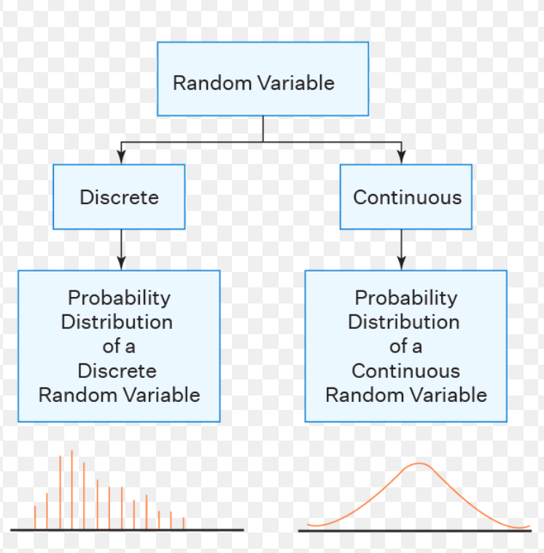
Probability Distribution
A function that gives the probabilities of different outcomes of a random variable.

Slide 53
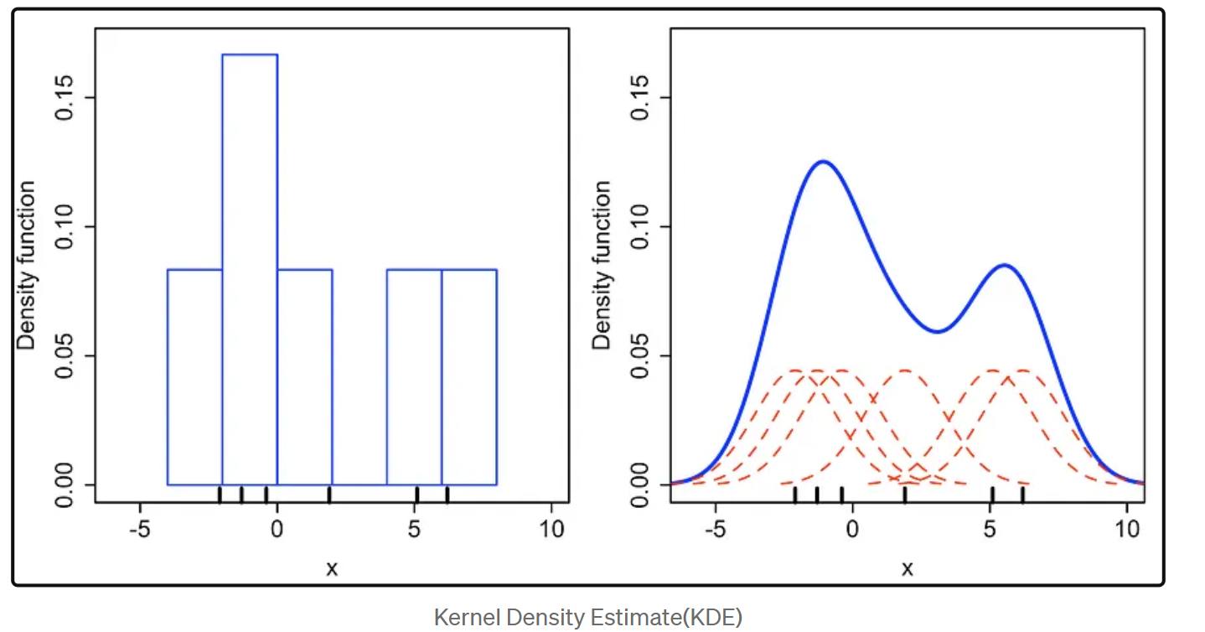
Probability Distribution Function (PDF)
A Probability Distribution Function describes how the probabilities of a random variable are distributed over its possible values.
Types Of PDF
Probability Mass Function (PMF) :A function that gives the probability that a discrete random variable is exactly equal to some value.
Probability Density Function (PDF): A function whose area under the curve over an interval gives the probability that the variable lies within that interval.
Kernel Density Function (KDE)
A Kernel Density Function is a way to show the distribution of data smoothly.
It is used for continuous data.
Unlike a histogram, it gives a smooth curve instead of bars.

Slide 54
Types of Probability Distributions
1. Bernoulli Distribution A probability distribution of a single trial that has exactly two possible outcomes: success (usually coded as 1) or failure (usually coded as 0).
Example: Tossing one coin, where head = success and tail = failure.
2. Binomial Distribution A probability distribution that describes the number of successes in a fixed number of independent trials, where each trial has only two possible outcomes: success or failure.
Example: Tossing 3 coins and counting the number of heads.
3. Poisson Distribution A probability distribution that describes the number of times an event occurs in a fixed interval of time or space, assuming the events occur independently and at a constant average rate.
Example: Number of calls received by a call center per hour.

Slide 55
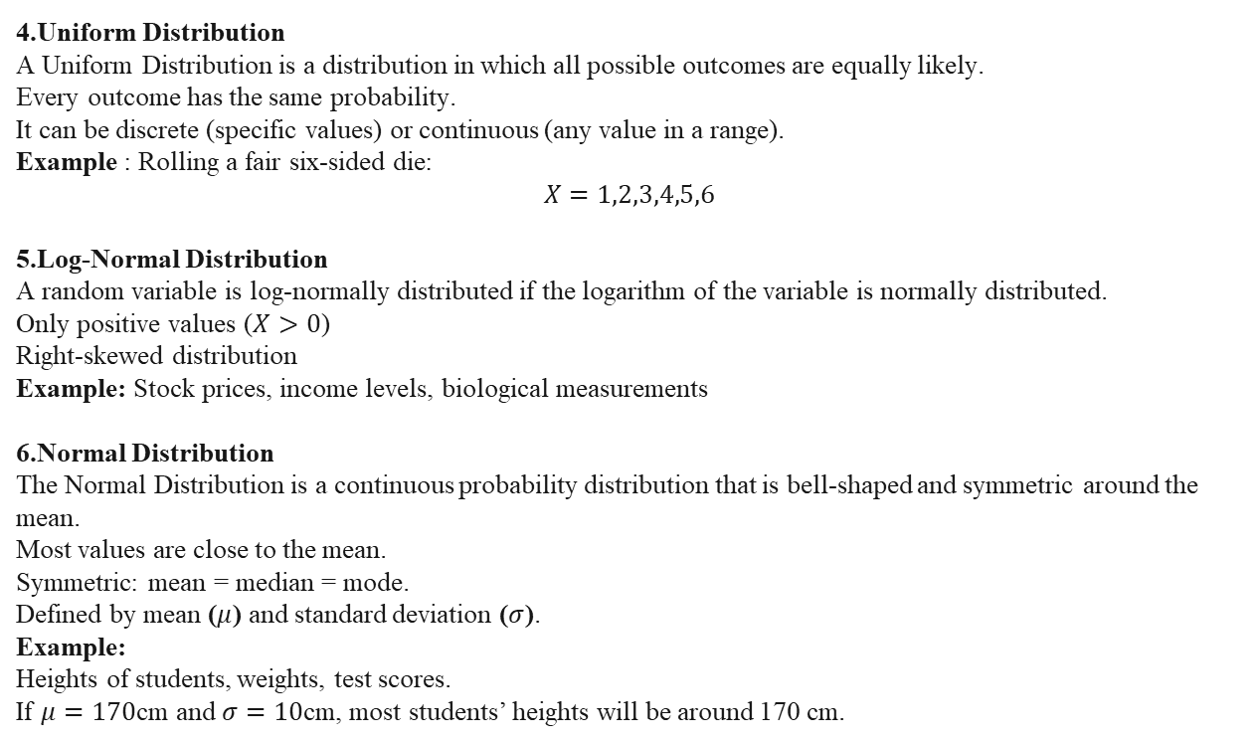
4.Uniform Distribution A Uniform Distribution is a distribution in which all possible outcomes are equally likely. Every outcome has the same probability. It can be discrete (specific values) or continuous (any value in a range). Example : Rolling a fair six-sided die: $$X=1,2,3,4,5,6$$ 5.Log-Normal Distribution A random variable is log-normally distributed if the logarithm of the variable is normally distributed. Only positive values ($X>0$) Right-skewed distribution Example: Stock prices, income levels, biological measurements 6.Normal Distribution The Normal Distribution is a continuous probability distribution that is bell-shaped and symmetric around the mean. Most values are close to the mean. Symmetric: mean = median = mode. Defined by mean ($μ$) and standard deviation ($σ$). Example: Heights of students, weights, test scores. If $μ=170$cm and $σ=10$cm, most students’ heights will be around 170 cm.

Slide 56
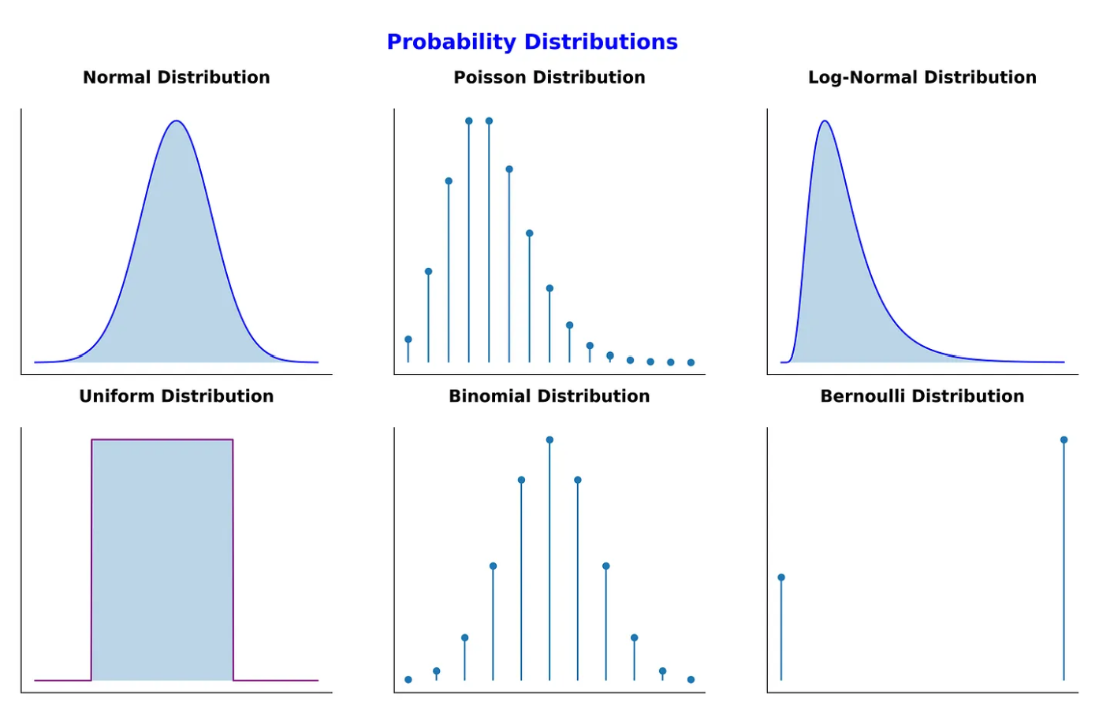

Slide 57
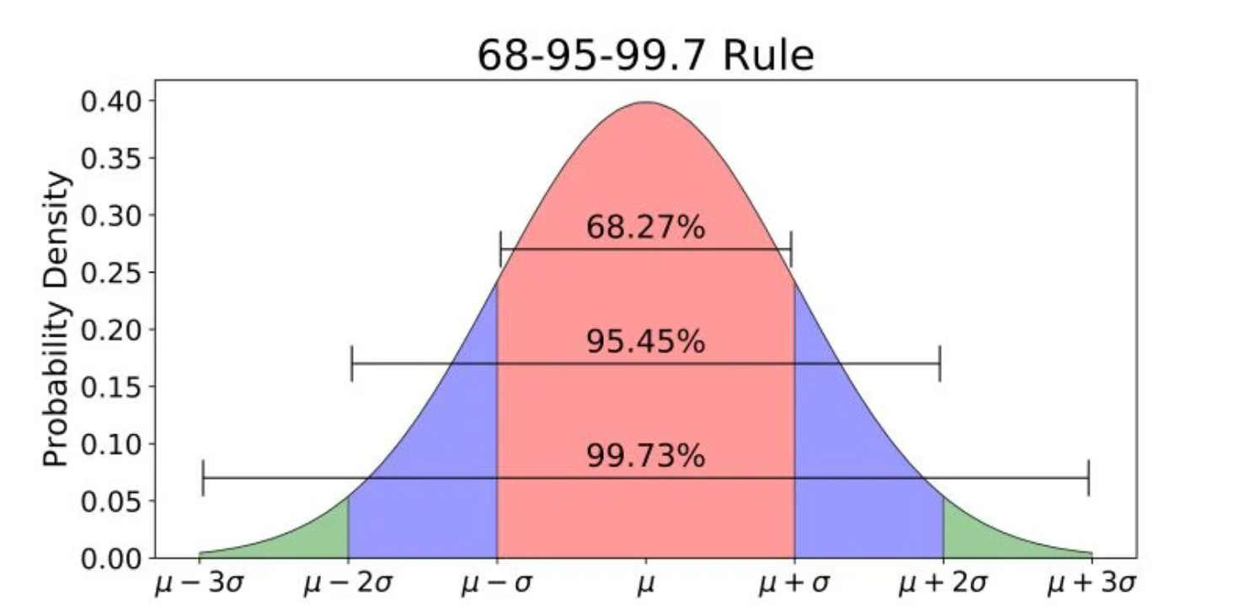
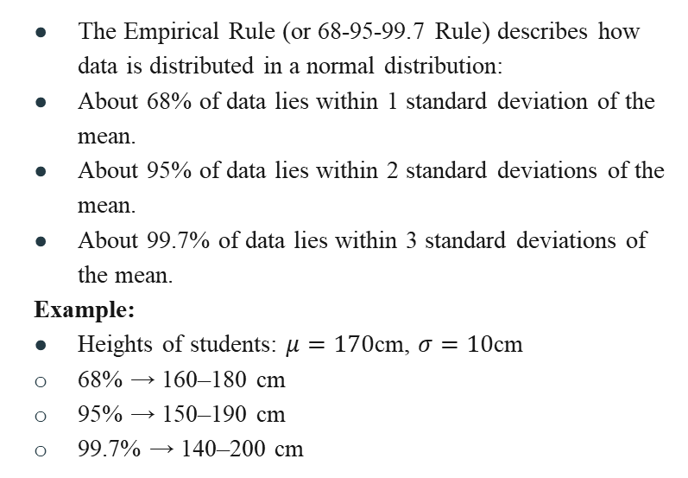
Empirical Rule of Normal Distribution
The Empirical Rule (or 68-95-99.7 Rule) describes how data is distributed in a normal distribution:
About 68% of data lies within 1 standard deviation of the mean.
About 95% of data lies within 2 standard deviations of the mean.
About 99.7% of data lies within 3 standard deviations of the mean.
Example:
Heights of students: $μ=170$cm, $σ=10$cm
68% → 160–180 cm
95% → 150–190 cm
99.7% → 140–200 cm

Slide 58
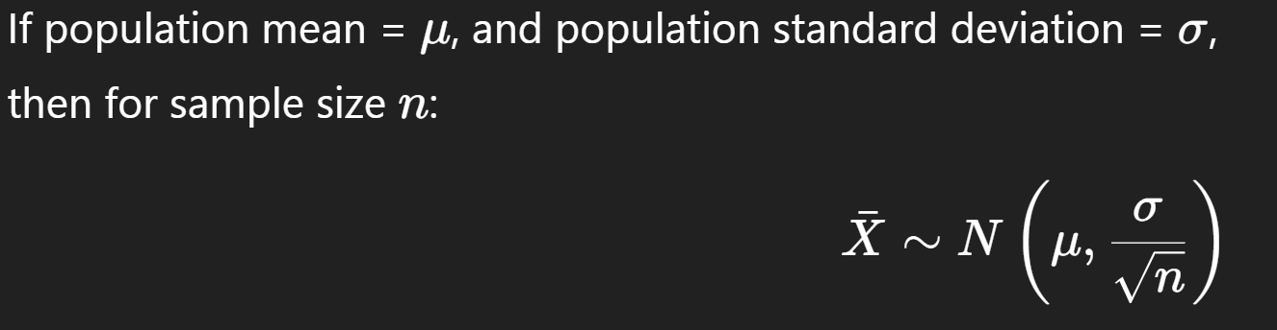
Central Limit Theorem (CLT)
The Central Limit Theorem states that: When we take many random samples of a large size from any population (whether normally distributed or not), the sampling distribution of the sample mean will approach a normal distribution as the sample size increases.
Key Points:
Works for any population distribution (skewed, uniform, exponential, etc.).
Sample size (n) should be large (usually n≥30is considered enough).
The mean of the sampling distribution = population mean (μ).
Formula:

Slide 59
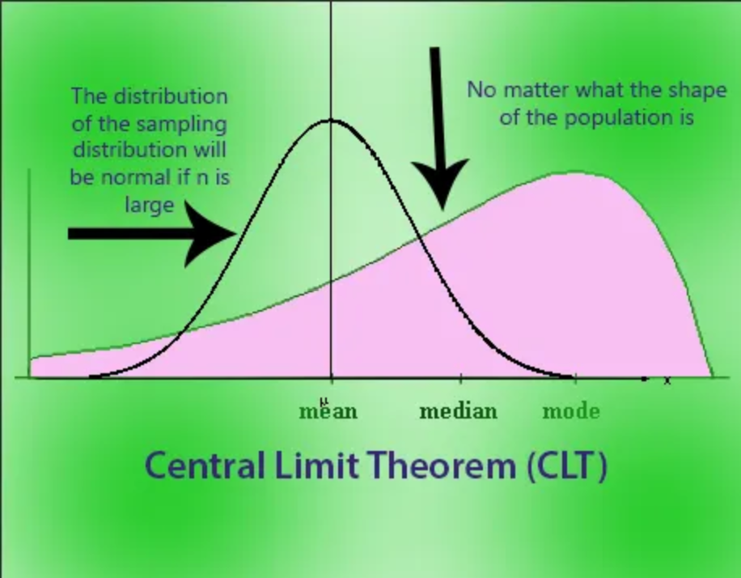
Example Population: Students’ marks (not normal, very mixed). Take samples of 50 students each. Calculate the average marks for each sample. These averages will form a bell-shaped curve.

Slide 60
Interview Questions
What is the difference between PMF and PDF?
PMF is used for discrete random variables. It gives the probability of exact values, like the chance of getting 2 heads in 3 coin tosses.
PDF is used for continuous random variables. For continuous data, probability of one exact value is zero, so we calculate probability over a range, like the chance that a person’s height is between 160–170 cm.
Explain the Bernoulli distribution with an example.
The Bernoulli distribution is the simplest one. It has only two outcomes: success or failure. For example, tossing a coin: if we take “Head” as success (1) and “Tail” as failure (0), then it follows
a Bernoulli distribution.

Slide 61
3. Explain the Binomial distribution with an example. The Binomial distribution is like doing the Bernoulli experiment many times. It tells us the probability of getting a certain number of successes in a fixed number of trials. For example, if I toss a coin 5 times, the probability of getting exactly 3 heads is given by the binomial distribution. 4. Explain the Poisson distribution with an example. The Poisson distribution is used when we are counting how many times an event happens in a fixed interval of time or space. For example, if a call center receives on average 10 calls per hour, the probability of getting exactly 7 calls in one hour can be found using the Poisson distribution. 5.What is the empirical rule in normal distribution? The empirical rule says that in a normal distribution: About 68% of the data falls within 1 standard deviation from the mean. About 95% falls within 2 standard deviations. About 99.7% falls within 3 standard deviations. It’s also called the 68–95–99.7 rule.

Slide 62
6. What is Central Limit Theorem in Statistics? Central Limit Theorem in statistics states that whenever we take a large sample size of a population then the distribution of sample mean approximates to the normal distribution. 7. When does Central Limit Theorem apply? Central Limit theorem applies when the sample size is larger usually greater than 30. 8. Why is Central Limit Theorem important? Central Limit Theorem is important as it helps to make accurate prediction about a population just by analyzing the sample.

Slide 63


